Slide 1
Project Presentation of Industry Oriented Hands on Experience (22CS422)
On
Student Performance Prediction
Name of Student1 : Muskan (ID:22109901944) Name of Student2 : Mugdha (ID:2210990585) Name of Student3 : Himanshi (ID: 2210990403)
Name of Student4 : Khushi (ID:22109901796)
Supervised By :
Dr. Rajat Takkar
Department of Computer Science and Engineering,
Chitkara University, Punjab

Slide 2
INTRODUCTION
This project presents an AI-based framework for analyzing, predicting, and visualizing student academic performance using machine learning techniques. Traditional evaluation methods are often manual, time-consuming, and unable to capture complex relationships between factors such as study hours, attendance, assignments, internal marks, and past academic performance.
To overcome these limitations, the system uses Linear Regression to predict final scores and Decision Tree classification to categorize students as pass or fail. It also integrates data visualization techniques to clearly represent trends, patterns, and feature importance. By identifying at-risk students early and providing actionable insights, the framework helps educators make accurate, data-driven decisions and improves overall academic outcomes in an efficient, scalable, and interpretable manner.
2

Slide 3
OBJECTIVE
The objective of this project is to design and develop an AI-based framework that analyzes and predicts student academic performance using machine learning techniques. It aims to identify key factors influencing performance, such as study hours, attendance, and internal marks, and use them to forecast final scores and classify students into pass or fail categories.
The system also focuses on detecting at-risk students at an early stage and presenting insights through clear data visualizations. Ultimately, the goal is to support educators in making accurate, data-driven decisions and improving overall student learning outcomes efficiently.

Slide 4
PROBLEM STATEMENT
Traditional methods of evaluating student academic performance rely heavily on manual analysis of marks, attendance, and reports, which are time-consuming, prone to errors, and often fail to capture complex relationships between multiple influencing factors.
These methods provide limited insights and do not support predictive analysis, making it difficult for educators to identify trends or take timely action. As a result, detecting at-risk students early and providing personalized academic support becomes challenging. With the increasing volume of educational data, there is a strong need for an intelligent, automated system that can efficiently analyze data, uncover hidden patterns, generate meaningful visualizations, and provide accurate predictions to enable proactive, data-driven decision-making in education.

Slide 5
METHODOLOGY
The methodology of this project follows a data-driven machine learning approach to analyze and predict student academic performance. Initially, academic data is collected, including study hours, attendance, assignment marks, internal marks, and previous GPA. This data is then preprocessed to handle inconsistencies, missing values, and formatting issues to ensure accuracy.
Next, Exploratory Data Analysis (EDA) is performed using visualizations to identify patterns and relationships between variables. Two machine learning models are then applied: Linear Regression for predicting final scores and Decision Tree Classification for categorizing students as pass or fail. The dataset is split into training and testing sets to evaluate model performance.
Finally, the system integrates these models into a prediction module that provides final score predictions, pass/fail classification, and risk level analysis, enabling informed decision-making.

Slide 6
FEATURES
1. AI-Based Performance Prediction
Uses machine learning models to accurately predict students’ final academic scores.
2. Dual Model Approach
Combines Linear Regression (score prediction) and Decision Tree (pass/fail classification) for better reliability.
3. Early Risk Detection
Identifies students at low, medium, and high risk, enabling timely intervention.
4. Data Visualization
Provides graphs and charts to clearly represent trends, patterns, and performance insights.
5. Multi-Factor Analysis
Considers multiple academic factors like study hours, attendance, assignments, internal marks, and GPA.
6. Decision Support System
Helps educators make data-driven decisions to improve student performance and outcomes.

Slide 7
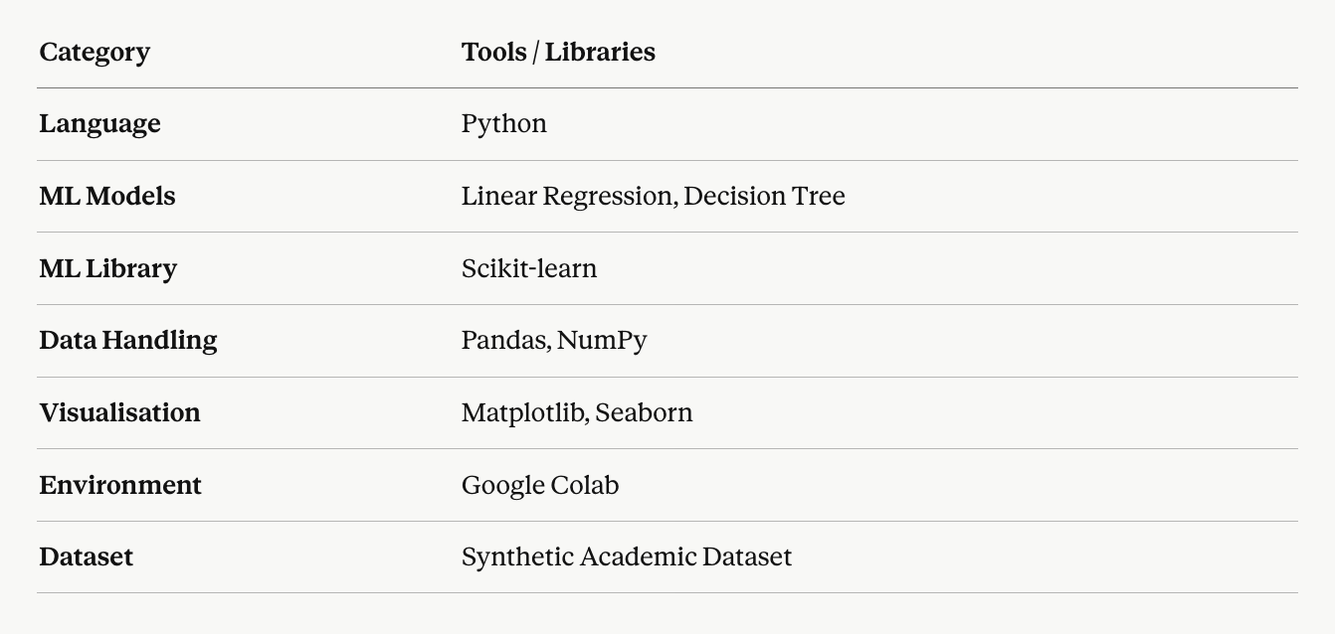
Technology Stack

Slide 8
OUTCOMES
Accurate Score Prediction — Linear Regression model successfully predicted final academic scores with ~85% accuracy, showing strong correlation with input features.
Pass/Fail Classification — Decision Tree Classifier effectively categorized students into Pass (56%) and Fail (44%) groups with reliable interpretable decision rules.
At-Risk Student Identification — Students classified into three risk levels (Low, Medium, High) based on predicted scores, enabling early educator intervention.
Meaningful Visualisations — Bar plots, pie charts, and attendance impact graphs revealed clear performance trends across the student dataset.
Balanced Dataset Advantage — Near-equal Pass/Fail distribution ensured unbiased model training, improving classification reliability.
Scalable & Interpretable Framework — The system is designed to be educator-friendly, explainable, and extendable to larger real-world datasets.

Slide 9
FUTURE SCOPE
Larger Real-World Datasets — Apply the framework on actual institutional data for improved prediction accuracy across diverse educational settings.
Advanced Algorithms — Integrate models like Random Forest, Neural Networks, or XGBoost for higher accuracy and better generalization.
Non-Academic Factors — Include psychological, socio-economic, and personal factors to build a more holistic student performance model.
Live Deployment — Convert the system into a real-time web or mobile application accessible directly by educators and students.
Personalized Interventions — Generate student-specific recommendations and study plans based on predicted risk levels.
Multi-Institutional Scalability — Expand the framework across multiple universities and course types for broader applicability.
Deep Learning Integration — Leverage deep learning for pattern recognition in complex, large-scale educational datasets.

Slide 10
CONCLUSION
This project successfully developed an AI-Based Framework for Academic Performance Visualisation using machine learning techniques. By analyzing key academic factors — study hours, attendance, assignment scores, internal marks, and past GPA — the system accurately predicts student outcomes and identifies at-risk learners.
The Linear Regression model predicted final scores with ~85% accuracy, while the Decision Tree Classifier effectively categorized students as Pass or Fail. Feature importance analysis confirmed that attendance, study hours, and internal marks are the strongest predictors of academic success.
The visualisation tools further simplified complex data into clear, actionable trends for educators. Despite limitations of a small synthetic dataset, the framework proves that AI can meaningfully support data-driven decision-making in education — enabling timely interventions and improved student outcomes overall.

Slide 11
Thank You
11

